Slide 1

OUR INHERITANCE
1 Corinthians 6:1-11

Slide 2
Matthew 19:28
And Jesus said unto them, Verily I say unto you, That ye which have followed Me, in the regeneration when the Son of Man shall sit in the throne of His glory, ye also shall sit upon twelve thrones, judging the twelve tribes of Israel.

Slide 3
James 2:6,8
But ye have despised the poor. Do not rich men oppress you, and draw you before the judgement seats?
If ye fulfill the royal law according to the Scripture, Thou shalt love thy neighbor as thyself, ye do well.

Slide 4
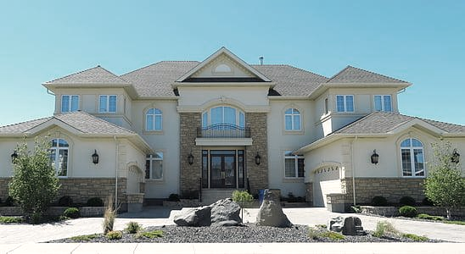

Slide 5
1 Peter 1:4
To an inheritance incorruptible, and undefiled, and that fadeth not away, reserved in heaven for you.

Slide 6
Leviticus 7:11
For the life of the flesh is in the blood: and I have given it to you upon the altar to make an atonement for your souls: for it is the blood that maketh an atonement for the soul.
Hebrews 9:13-14
For if the blood of bulls and of goats, and the ashes of an heifer sprinkling the unclean, sanctifieth to the purifying of the flesh:
How much more shall the blood of Christ, who through the eternal Spirit offered Himself without spot to God, purge your conscience from dead works to serve the living God?

Slide 7
WASHED
SANCTIFIED
JUSTIFIED
1 Peter 2:9
But ye are a chosen generation, a royal priesthood, an holy nation, a peculiar people; that ye should show forth the praises of Him who hath called you out of darkness into His marvelous light.

Slide 8
1 Corinthians 15:57-58
But thanks be to God, which giveth us the victory through our Lord Jesus Christ.
Therefore my beloved brethren, be ye steadfast, unmoveable, always abounding in the work of the Lord, forasmuch as ye know that your labor is not in vain in the Lord.

Slide 9
Stay strong!
Love God!
Love people!
You have an eternal inheritance,
so love like Jesus loved!

